Slide 1


Slide 1
Stock Prediction
J. Hills and R. Mih

Slide 2



Slide 3
Our Goal was to Better Understand the Important
Contributors to Stock Price Modelling
e
?
?
DataSize
Algorithm
Impact of Data Size:
3 years
9 years
Impact of model choice :
Decision Tree Classification or Support Vector Machine
?
?
Features
Metric
Impact of Features
Single Moving Average
Exponential Moving Average
High-low Span
….
Impact of selecting the “Y-axis”: “To buy ?” or
“Up or Down?”
3

Slide 3





Slide 9
Tools Used – Decision Tree
EXTRACT
MACHINE LEARNING
API Call to AlphaVantage
For daily stock open, high, low and close data
SciKit Learn for Trying different models, tuning, analysis of results.
TRANSFORM
VISUALIZATION
Python and Pandas to read the data and manipulate.
Tableau, to communicate the results.
Your logo
9

Slide 4

























Approach – Decision Tree
The Decision Tree Classification Model was setup with 25 different stocks similar to the Dow Jones 30, 3 years of data, and 5 features.
The goal was to identify a stock that would have a 2.5% price change or higher the next day

Slide 5


Slide 7
72%
73%
13%
The Decision Tree Classification Model was setup with 25 different stocks similar to the Dow Jones 30, 3 years of data, and 5 features.
After hyper-parameter tuning, the progression of the metrics is shown
Since the data was unbalanced I had to change the metric with which the model was optimized

Slide 6
Slide 4
Decision Tree Classification Key Features
Significance of Open Less than close is missed
High Low Span increases by
45%
Increased accuracy by
5%
For the Feature Importances, the generic untuned model correctly identified Low Span as the most important parameter
As a result of tuning the model we see that the Feature Importances change dramatically
The last effort to improve the model was to reduce the input parameters so that only the significant ones were used
4

Slide 7

Slide 10
As you can see the Recall for each stock suffered a good amount of variance from stock to stock
Decision Tree
Classification Results
DTC Recall Results are shown for the 25 stocks as a function of the testing and training data
10

Slide 8
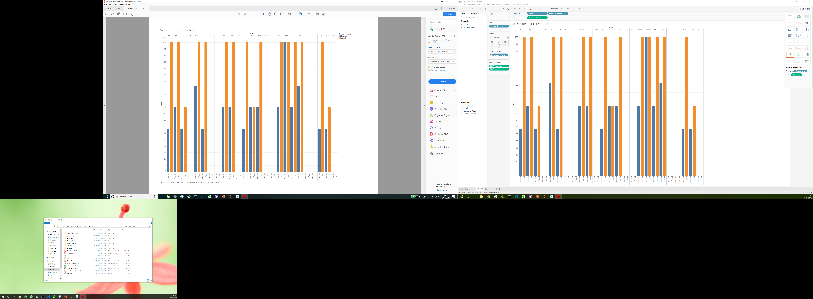
Prediction Performance – Decision Tree
While Recall was the better metric for performance, we never achieved results that generated a useful model

Slide 9
Discussion – Decision Tree
Overall it was very difficult to generate a model that had both good accuracy as well as good recall.
The imbalanced data either made it so we either had no predictions or we retained a low value for precision
If you actually wanted to trade with this model then you have approximately a 1 in 5 to 1 in 10 chance that you will achieve the predicted target of a 2.5% price increase

Slide 10
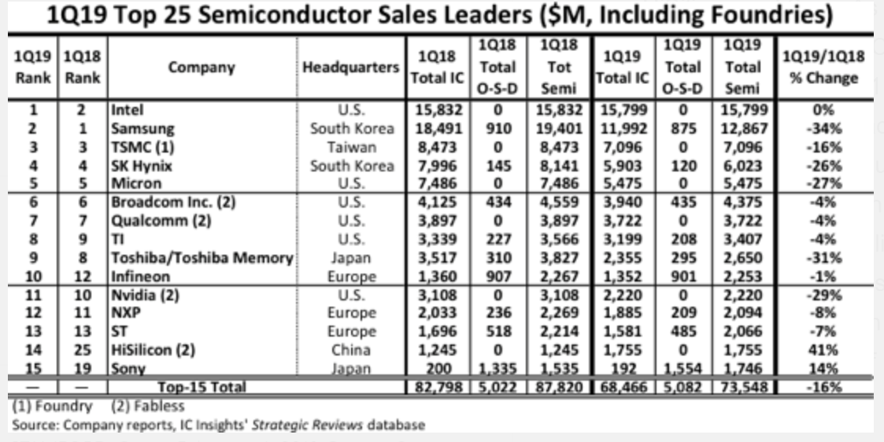
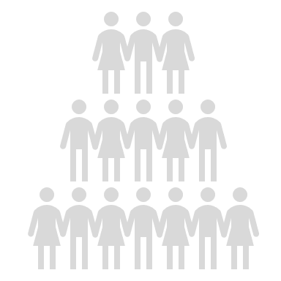
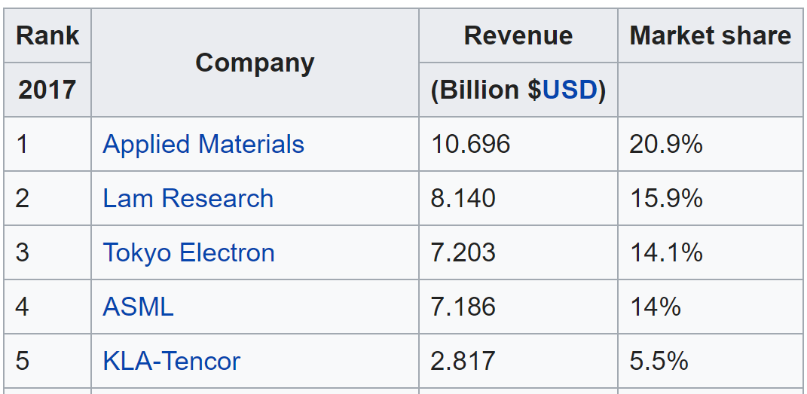
Slide 7
Suppliers
Buyers
The Support Vector Machine Model was setup with 9 years of stock data, for 11 Individual stocks which relate to the Semiconductor Industry – Chip Buyers, Chip Suppliers, and Chip-making Equipment Vendors
Buyers: Apple, Qualcomm, Broadcom, Nvidia,
Suppliers: Intel, Micron, TSMC, TI
Vendors: Applied Materials, Lam Research, ASML
Vendors

Slide 11











Slide 9
Tools Used
EXTRACT
TRANSFORM
MACHINE LEARNING
VISUALIZATION
Yahoo for DJIA and SP500 Index data
API Call to AlphaVantage
For daily stock open, high, low and close data
SciKit Learn for Trying different models, tuning, analysis of results. Pickle
Matplotlib
Python and Pandas to read the data and manipulate
Tableau, to communicate the results.
Single Moving Average (SMV)
Exponential Moving Average (EMV)
Above based on time periods: 4, 12, 26, 50, 200 days
High-Low Span
High above EMA4, Close above EMA4
Day to Day High-Low change(%)
Day to Day Volume change (%)
Volume change to EMA
Y-axis: Predict whether next day close with go up or down from today (1 = up, -1 = down)
Support Vector Machine Classification
Optimization: Grid Search on C, and Gamma
Characterization tools :
Confusion Matrix
Correlation Matrix (Matplotlib)
Metrics: Accuracy, Recall, F-Factor
Train, Test on data from 2010 to April 2019, Predict on new data May 2019
11

Slide 12
Slide 7
Linear
Is best
Without Tuning = 55% - 66% Accuracy
85%
85%
85%
Started with just 1 stock : AAPL
Use 16 Features which are all scaled values.
After hyper-parameter tuning, fairly good accuracy, recall, and precision were obtained (>80%) as shown at right
Using a metric of “Will the stock go up or down tomorrow”, is an easier metric and leads to a more balanced dataset

Slide 13
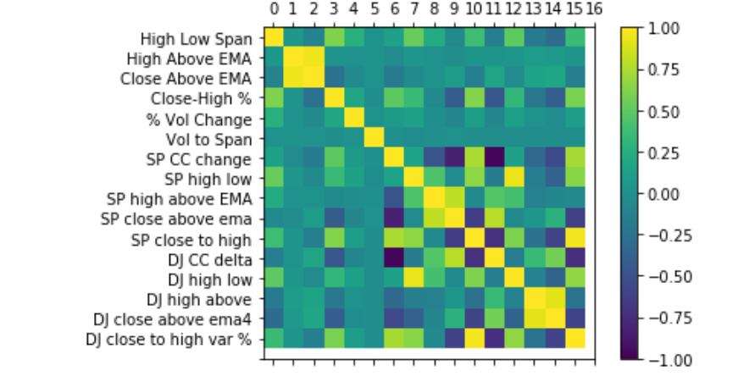
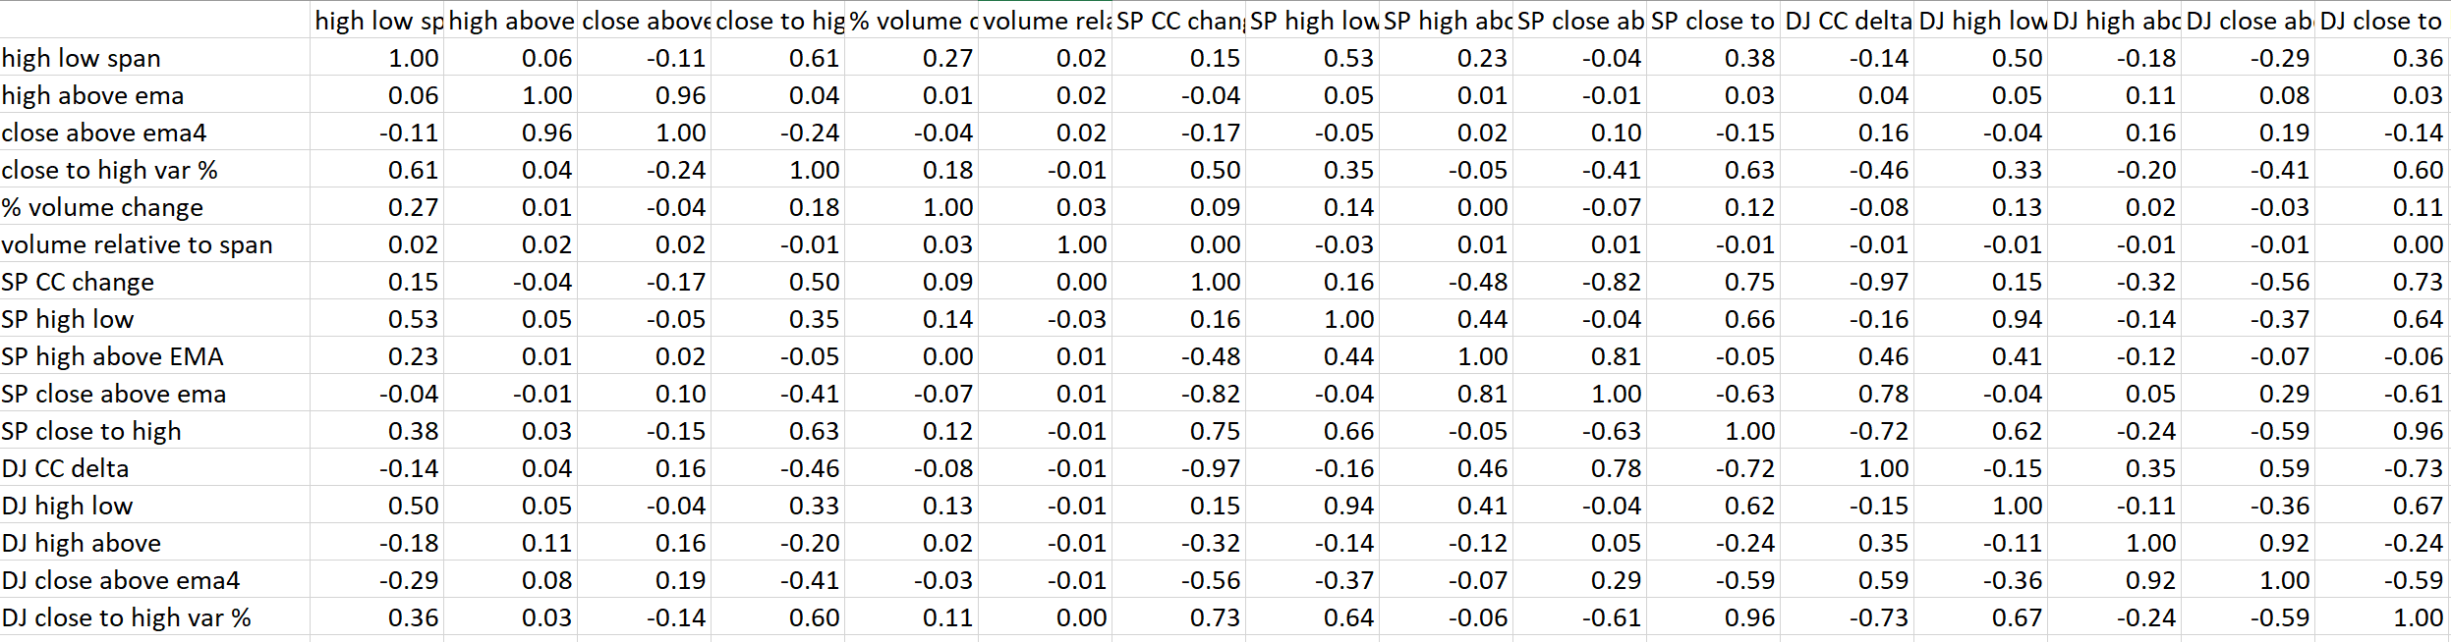
Slide 10
Use of Correlation Matrix
AAPL Stock + SP500 + DJ30 Index
Some strong correlations seen (>0.9
Or <- 0.9)
Some Low correlations (0.1 or lower)
Check the actual values, sometimes the color coding is mis-leading
Removal of over-correlated features did reduce the accuracy a few % (83%)
The correlation matrix is a Matplotlib library that calculates the statistical correlation between features.
It doesn’t depend on the model used, so (in hindsight) I realized it’s a good idea to look at the correlation matrix FIRST, and potentially prune out features which have no very little correlation ( 0.1 or > 0.9
13

Slide 14
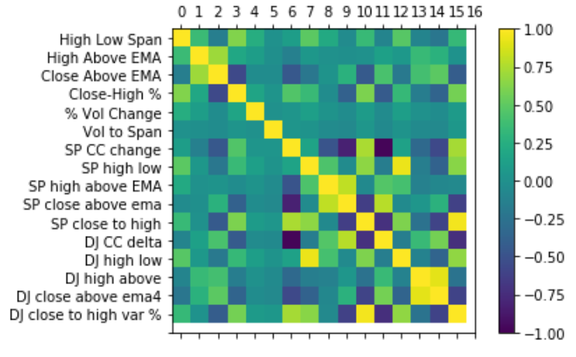
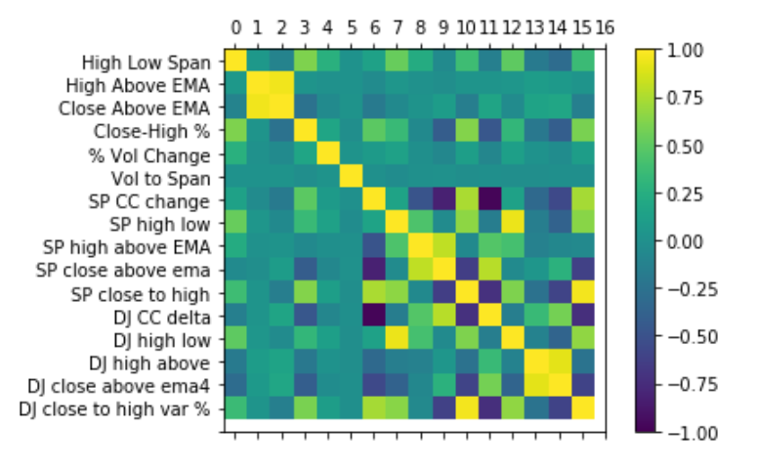
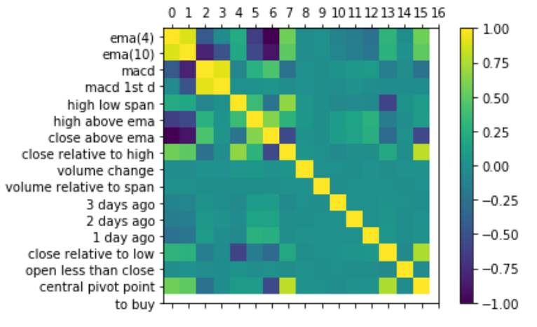
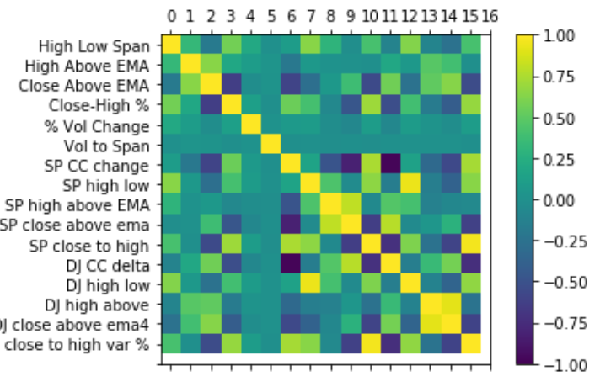
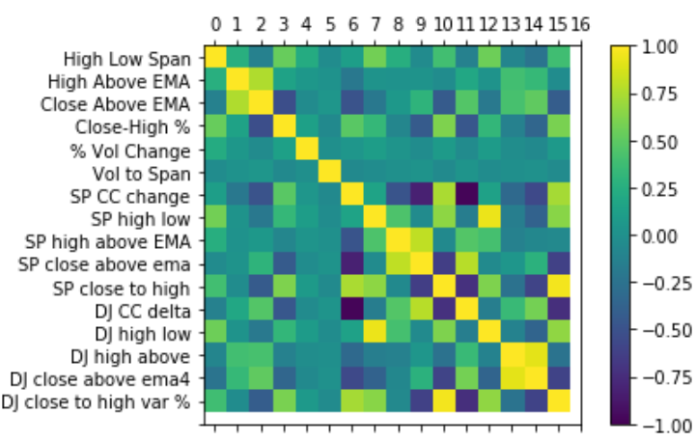
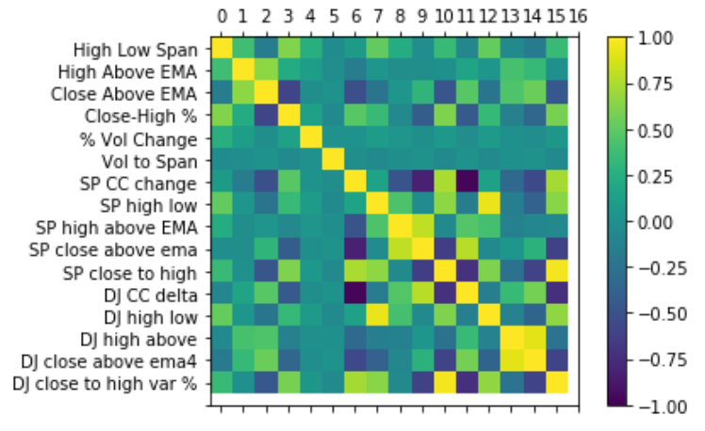
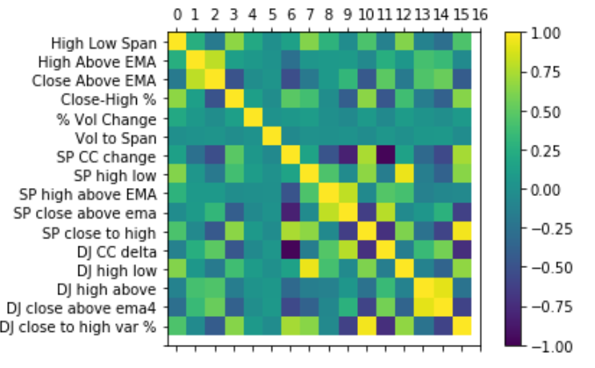
Correlation Matrix Comparisons by Stock and by Features
In all cases the SVM model was used
16 features
In one case we modelled 6 features from the stock
5 features from SP500 and 5 from DJIA
In the other case, all 16 features came from the
stock

Slide 15
Slide 4
SVC Key Features
When you tune each stock separately, the model is very consistent in accuracy, precision, recall
However the models are different – you can’t apply the same model to all stocks
The algorithm or model you use may not matter as much as the metric you use
Buyers
Suppliers
Vendors
SVC model, 16 feature parameters,
Metric: Will the stock go up or down tomorrow?
Very similar results irrespective of company
Linear Kernel is the best fit for all
SVC Model, 16 features, Linear model
Applied AAPL model to all stocks
Will the stock go up or down tomorrow?
Using the same APPL dataset on both models 16 features,
Metric: will the stock go up or down?
DTC can perform as well as SVM
4

Slide 16
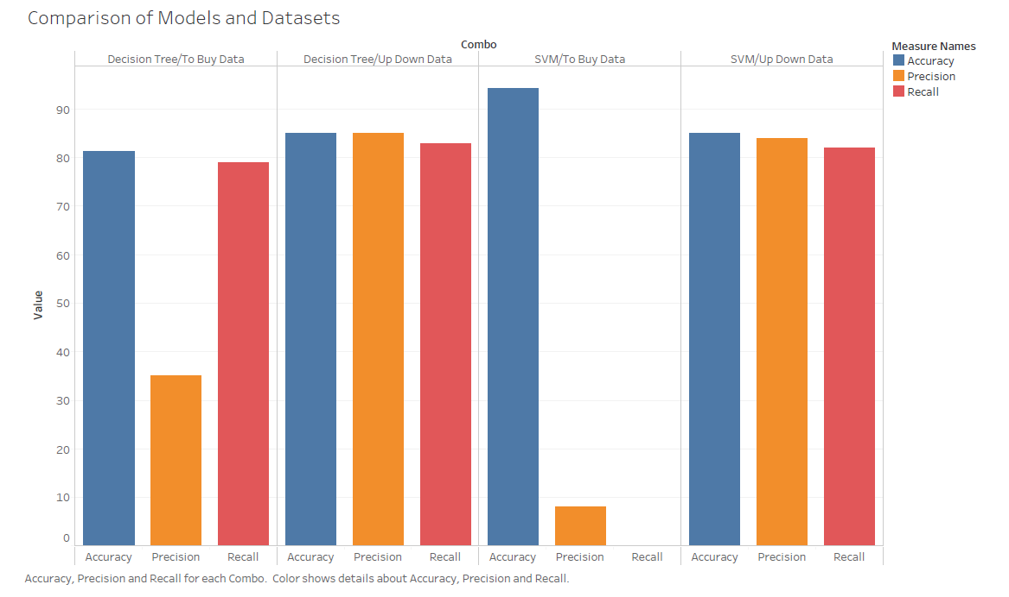
Model Comparison
We wanted to compare how well each model performed on the other’s dataset, so we ran each other’s data in our models and achieved the following results

Slide 17

Slide 11
THANK YOU

